Slide 1
Pima Indians Diabetes Study

Slide 2
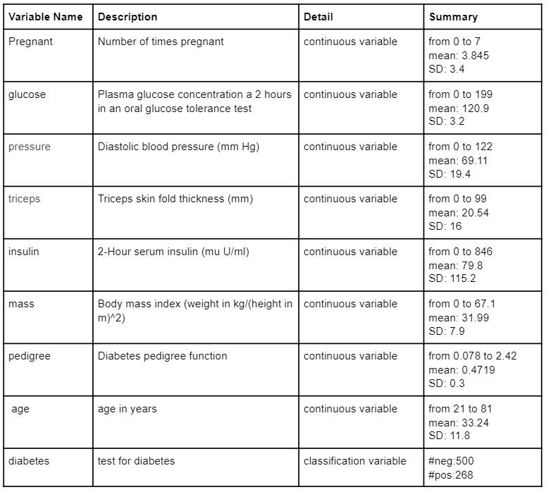
Data Introduction:
Pima Indians Diabetes dataset is gathered by the National Institute of Diabetes and Digestive.
Dataset has 8 independent medical predictors and 1 binary response, total 768 observations on 9 variables.
Data Cleaning
Removing missing values
392 observations on 9 variables
Notes:
Mention: we did data cleaning to remove the missing values.

Slide 3
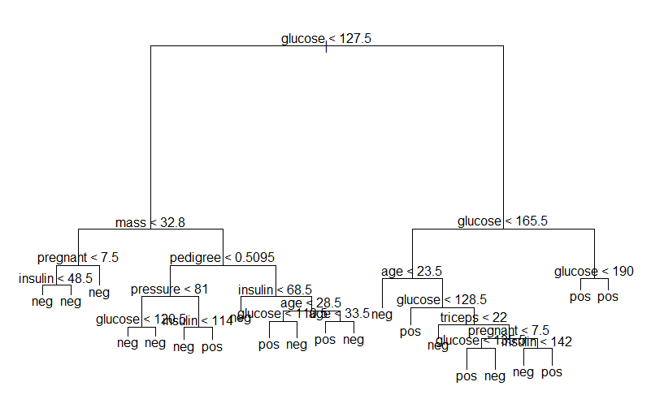
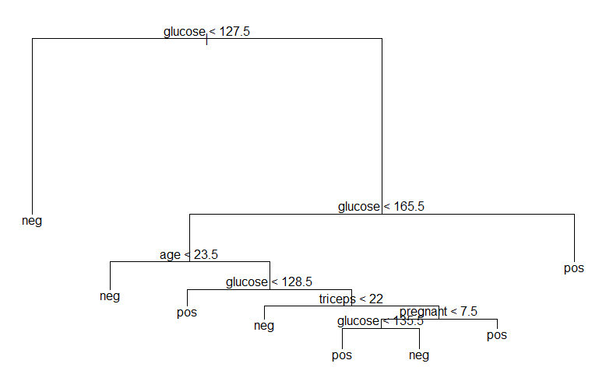


Single Tree / Prune
best.k=8
Test error
Rate: 30.8%
Test error
rate: 28.3%
Notes:
Which variable is important?

Slide 4
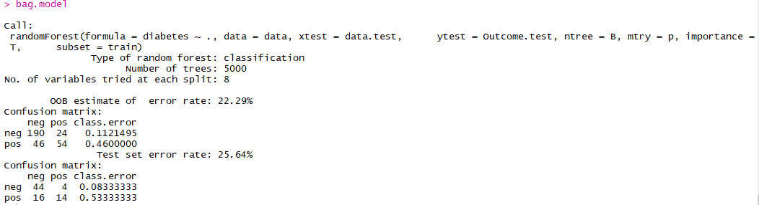
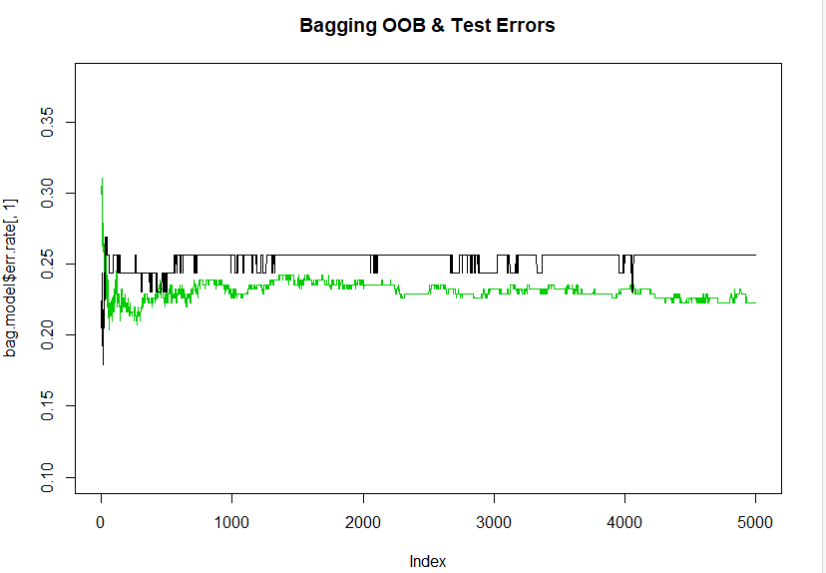
Bagging Tree
Bagging Tree Test set error rate is 25.64%, among 30 true diabetes, only 14 got tested, detect rate is 1-0.533=0.467

Slide 5
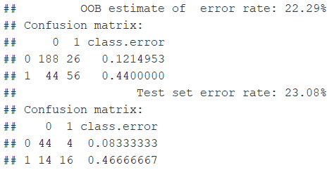
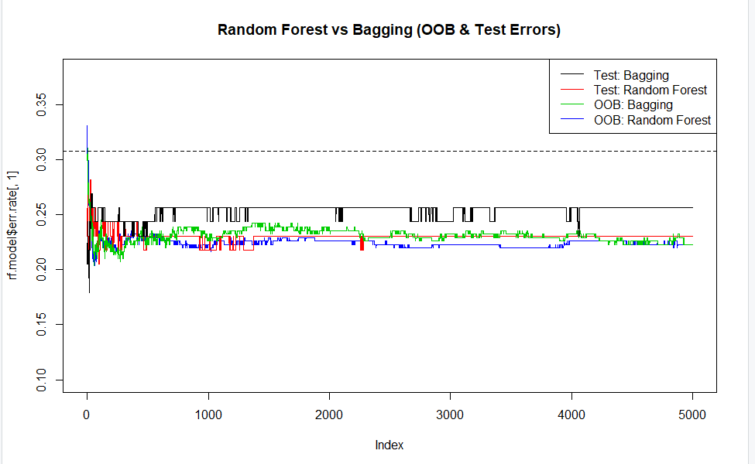
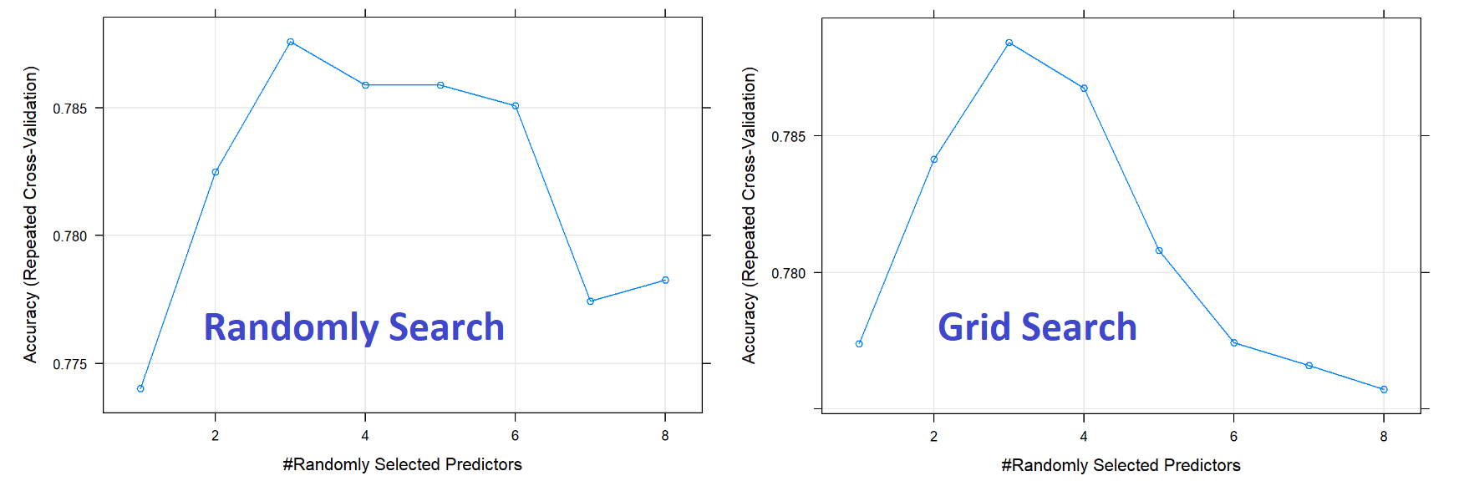
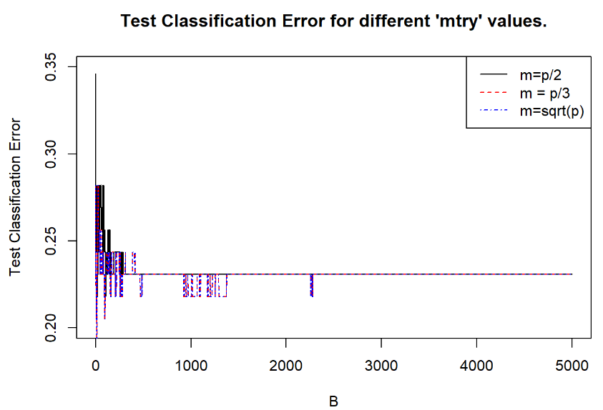
Random Forest Tree
Better Positive Detection
Mtry: sqrt(p) =2.82 ~3

Slide 6
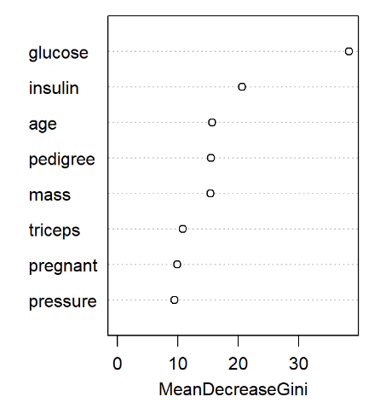
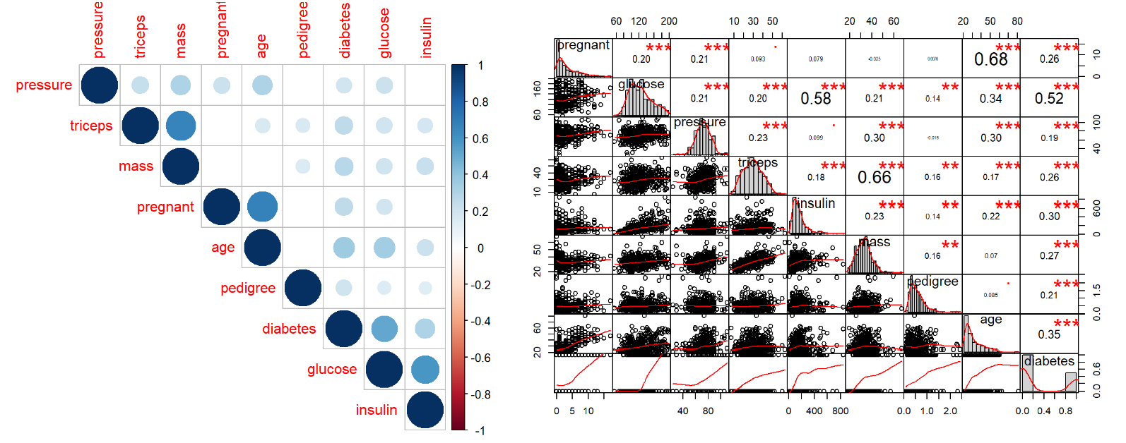
Variable Importance
Importance Ranking Variable Correlation

Slide 7
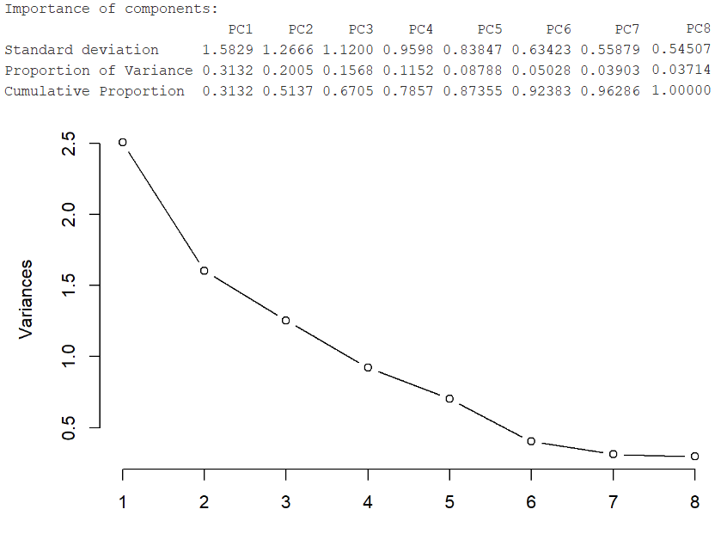
Principal Component Analysis
PC selects: all 8 PCs
# PCs | 2 | 3 | 4 | 5 | 6 | 7 | 8
Test Error | 26.56 | 25.64 | 24.74 | 24.87 | 23.85 | 23.20 | 21.28
False Neg | 42.39 | 46.12 | 40.05 | 40.28 | 39.25 | 38.31 | 36.54
Remove set.seed, add randomness to model
 | 8 Variables |  | 8 PCs
# Loop | Test Error Rate | False Negative | Test Error Rate | False Negative
N=10 | 19.74 | 39.24 | 22.43 | 40.09
N=100 | 21.21 | 38.27 | 23.74 | 40.00
N=1000 | 21.79 | 38.71 | 23.81 | 40.78
No Need PCA

Slide 8
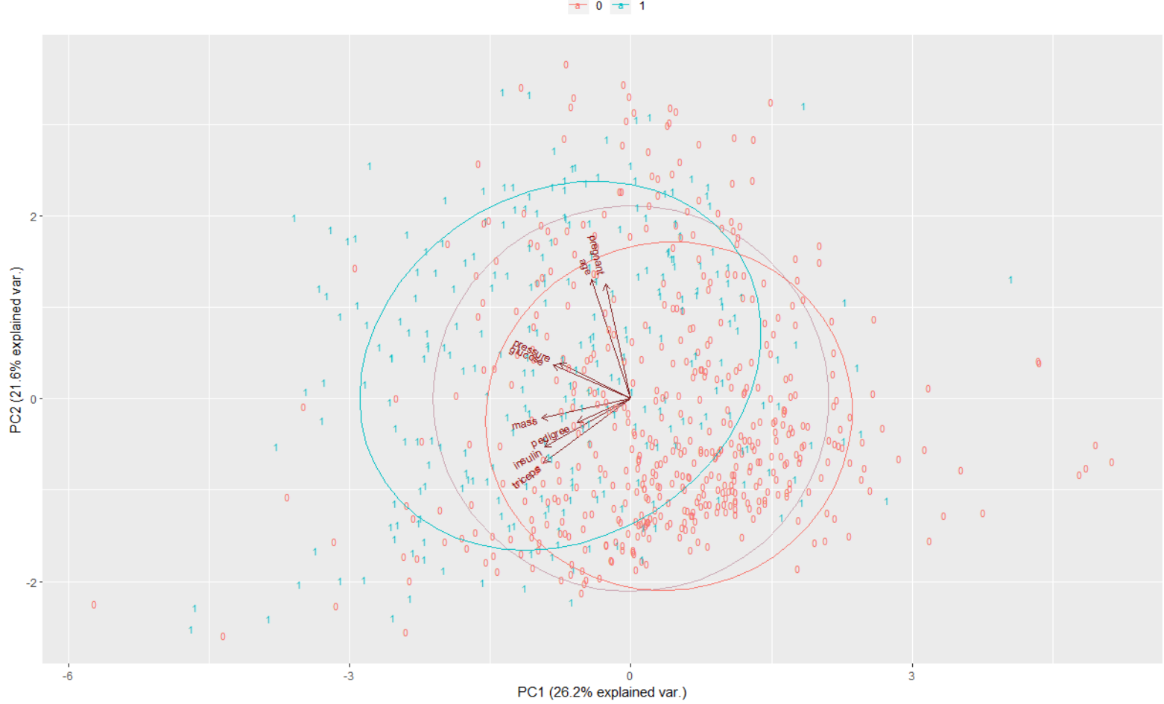
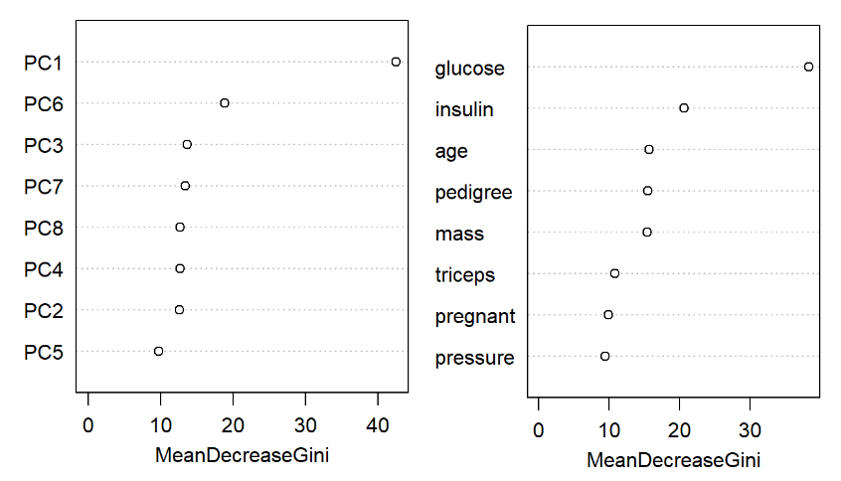
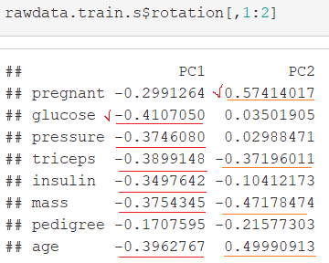
Principal Component Analysis
PC1: Health indicators, body feature
PC2: Natural extragenetic feature
Grouped variables -> strong Correlation
Notes:
In principal, the linear transformation performed by PCA can be performed just as well by by the input layer weights of the neural network, so it isn't strictly speaking necessary. However, as the number of weights in the network increases, the amount of data needed to be able to reliably determine the weights of the network also increases (often quite rapidly), and over-fitting becomes more of an issue (using regularisation is also a good idea). The benefit of dimensionality reduction is that it reduces the size of the network, and hence the amount of data needed to train it.

Slide 9
Reduce Variable
Remove set.seed, add randomness to model
 | Test Error Rate | False Negative
Original Full Set | 19.74 | 39.24
-Pressure | 22.56 | 44.48
...-Pedigree | 22.95 | 36.06
…-Triceps | 20.64 | 31.70
…-Pregnant | 17.69 | 33.61
…-Mass | 22.69 | 37.28
…-Insulin | 21.92 | 40.30

Slide 10
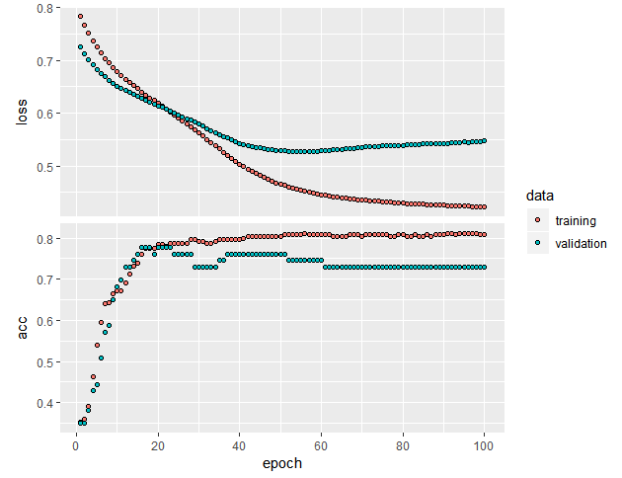
Artificial Neural Networks
Epoch=100
Early Stop
Multiple hidden layer
Input layer nodes: 8
Hidden layer nodes: 5 (Relu)
Output layer nodes: 2
Performance: val_loss: 0.5472
val_acc: 0.7302
loss: 0.4226
acc: 0.808
Test accuracy: 0.8227848
Input layer nodes: 8
Hidden layer nodes: 5 (Relu)
Output layer nodes: 2
epochs=75
Performance: val_loss: 0.5379
val_acc: 0.7302
loss: 0.4323
acc: 0.808
Test accuracy: 0.835443
Input layer nodes: 8
Hidden layer nodes: 5 10 10 10 (tanh)
Output layer nodes: 2
epochs=95
Performance: val_loss: 0.4893
val_acc: 0.7302
loss: 0.3934
acc: 0.804

Slide 11
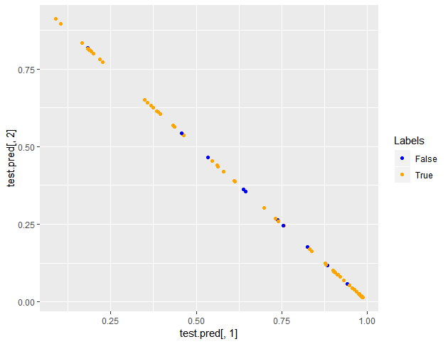
Model performance
Actual
Prediction 0 1
0 46 2
1 9 22
Test Accuracy:86.07%
Notes:
12/19, 0.797
10/15, 0.835
14/15, 0.747
8/13, 0.785
10/16, 0.797

Slide 12
Reduce Variable
Diabetes~glucose+age
+insulin
Diabetes~glucose+age+insulin
+pregnant+mass
Diabetes~ glucose+age
Input layer nodes: 2
Hidden layer nodes: 2 (Relu)
Output layer nodes: 2
epochs=86
Performance: val_loss: 0.5384
val_acc: 0.7143
loss: 0.4886
acc: 0.676
Test accuracy: 0.6075949
Input layer nodes: 3
Hidden layer nodes: 2 (Relu)
Output layer nodes: 2
Epochs = 62
Performance: val_loss: 0.5645
val_acc: 0.746
loss: 0.4892
acc: 0.744
Test accuracy: 0.7594937
Input layer nodes: 5
Hidden layer nodes: 4 (Relu)
Output layer nodes: 2
Epochs = 382
Performance: val_loss: 0.435
val_acc: 0.8254
loss: 0.4029
acc: 0.804
Test accuracy: 0.7848101
Notes:
(with both one hidden layer node # = avg(input, outp)
0.7848 test err full set, 0.7974 test err -pressure, -pedigree, -triceps

Slide 13
Reduce Variable
Diabetes~glucose+age
+insulin
Diabetes~glucose+age+
insulin+pregnant+mass
Diabetes~ glucose+age
Input layer nodes: 2
Hidden layer nodes: 6 10 12 6 4 (tanh)
Output layer nodes: 2
epochs=15（patience=10）
Performance: val_loss: 0.5362
val_acc: 0.7143
loss: 0.4615
acc: 0.788
Test accuracy: 0.8607595
Input layer nodes: 3
Hidden layer nodes: 6 10 8 6 4 (tanh)
Output layer nodes: 2
Epochs = 20（patience=10）
Performance: val_loss: 0.5328
val_acc: 0.6984
loss: 0.461
acc: 0.78
Test accuracy: 0.8607595
Input layer nodes: 5
Hidden layer nodes: 8 10 12 8 4 (tanh)
Output layer nodes: 2
Epochs = 43
Performance: val_loss: 0.4633
val_acc: 0.7619
loss: 0.4142
acc: 0.816
Test accuracy: 0.8227848
Notes:
8,15,8
11/20, 0.835
10/15, 0.827
14/15, 0.797
4/17, 0.823
12/14, 0.79
10/20, 0.800

Slide 14
Reduce Variable-rule of thumb
Diabetes~glucose+age
predict
actual 0
0 48
1 31
Test Error Rate：39.24%
False Negative：100%
Diabetes~glucose+age+insulin
predict
actual 0 1
0 46 2
1 17 14
Test Error Rate：24.05%
False Negative：54.83%
Diabetes~glucose+age+insulin+pregnant+mass
predict
actual 0 1
0 43 5
1 12 19
Test Error Rate：21.52%
False Negative：38.71%
Diabetes~.
predict
actual 0 1
0 46 2
1 11 20
Test Error Rate：16.46%
False Negative：35.48%
Notes:
In this case, the more variables we remove from ANN, the worse performance in test error rate and false negative.

Slide 15
Reduce Variable-multiple hidden layers
Diabetes~glucose+age
predict
actual 0 1
0 47 1
1 10 21
Test Error Rate：13.92%
False Negative：32.26%
Diabetes~glucose+age+insulin
predict
actual 0 1
0 47 1
1 10 21
Test Error Rate：13.92%
False Negative：32.26%
Diabetes~glucose+age+insulin+pregnant+mass
predict
actual 0 1
0 46 2
1 12 19
Test Error Rate：17.72%
False Negative：38.71%
Diabetes~.
predict
actual 0 1
0 46 2
1 9 22
Test Error Rate：13.92%
False Negative：29.03%

Slide 16
Perceptron
Estimations on weights and bias with predictor selection
bias | pregnant | glucose | pressure | triceps | insulin | mass | pedigree | age | Error Rate
-3579 | 1536 | 274 | -1076 | -39 | 43 | -589.2 | 2576.28 | 588 | 31.63
-5136 |  | 129 |  |  | 197 | -1209.7 | 3158.84 | 288 | 42.09
-7347 |  | -55 |  |  |  |  |  | -8 | 33.16

Slide 17
Model Comparison
Full Set | Single / prune | Bagged Tree | Random Forest |  | ANN (1 hidden layer)
 |  |  | Test Error | False Negative | Test Error | False Negative
N = 10 | 24.10 | 25.12 | 19.74 | 39.24 | 11.39 | 25.00
5 Subset | Random Forest |  | ANN (1 hidden layer)
 | Test Error | False Negative | Test Error | False Negative
N = 10 | 20.64 | 31.70 | 25.31 | 50.01
Conclusion
Always look at the data and research goals to find out the best model
Decorrelate variables by subset of predictors can improve RF, but not ANN
ANN predict results better with more informations even if they are correlated

